Slide 1



Stock Market Index Prediction Using Machine Learning

Slide 2
Presented By:
SHUBHRANIL MAZUMDER (123200803209)
ANUPAM DUTTA (123200803202)
SUMAN MANNA (123190803113)
SUTAPA DAS (123190803117)
SANJOY BANIK (123200803208)
Under the supervision of Prof. Debashree Mitra & Dr. Pranati Rakshit

Slide 3


Content:
Introduction
S & P 500 INDEX CHART
Project Objectives
Implementation Objectives
Block Diagram
Proposed Work
Methodology
Description of Algorithm used
Proposed Work
Result Analysis
ROC Curve
Future Scope
References

Slide 4

Introduction
The prediction of stock market indices is a challenging and important problem that has attracted considerable attention from researchers and practitioners in finance and economics.
In recent years, machine learning has emerged as a powerful tool for predicting the future value of stock market indices.
In this research project, we propose a machine learning-based approach using the Random Forest Classifier algorithm to predict the future value of the stock market index, specifically the S&P 500.
The data for this project will be collected using the yfinance API, which provides access to historical financial data for a wide range of stocks and indices. The collected data will be preprocessed to remove missing values, normalize the data, and engineer new features
The proposed system has the potential to provide valuable insights to investors and financial analysts, allowing them to make informed decisions and optimize their investment portfolios.

Slide 5
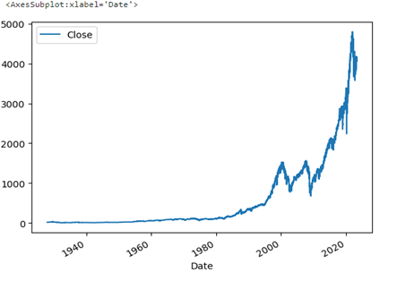
S & P 500 INDEX CHART

Slide 6
Project Objectives
Develop a predictive model: Our main objective is to develop a predictive model that can accurately forecast the future values of the S&P 500 index. This model will help investors and financial institutions make informed decisions regarding their investment strategies.
Data collection and preprocessing: We aim to collect comprehensive and reliable data on the S&P 500 index using the yfinance API. We will preprocess the data by removing irrelevant features and cleaning any inconsistencies or missing values to ensure the accuracy and integrity of the dataset.
Feature engineering: We will explore and incorporate additional predictors and features that can enhance the predictive power of our model. This may include factors such as rolling averages, trend indicators, economic indicators, and other relevant variables that can provide valuable insights into the behavior of the stock market.

Slide 7
Project Objectives
Model training and evaluation: We will employ machine learning algorithms, specifically the RandomForestClassifier, to train our predictive model. We will optimize the model's parameters and evaluate its performance using various metrics such as accuracy, precision, recall, and F1-score. This will enable us to assess the model's effectiveness in capturing the patterns and trends in the S&P 500 index data.
Model interpretation and analysis: We will analyze the results and interpret the model's predictions to gain insights into the behavior of the stock market. We will evaluate the significance of different predictors and identify the key factors driving the market trends.
Future scope and updating: Lastly, we will discuss the future scope of our project and potential avenues for improvement. We will explore possibilities for incorporating additional data sources, refining the model architecture, and integrating advanced techniques such as ensembling to further enhance the accuracy and robustness of our predictions.

Slide 8
Implementation Objectives
Real-time stock market prediction: One of our main objectives is to develop a practical implementation of the predictive model that can generate real-time predictions for the S&P 500 index.
User-friendly interface: We aim to create a user-friendly interface for our predictive model, making it accessible and easy to use for investors and financial professionals.
Integration with financial platforms: To maximize the practical utility of our project, we plan to integrate the predictive model with existing financial platforms or tools.
Scalability and efficiency: We strive to ensure that our implementation is scalable and efficient, capable of handling large volumes of data and generating predictions in a timely manner.
Continuous model updating: The stock market is dynamic and constantly evolving, requiring frequent updates to the predictive model.
Performance evaluation and validation: We will conduct rigorous performance evaluation and validation of our implementation to assess its accuracy, reliability, and effectiveness.

Slide 9
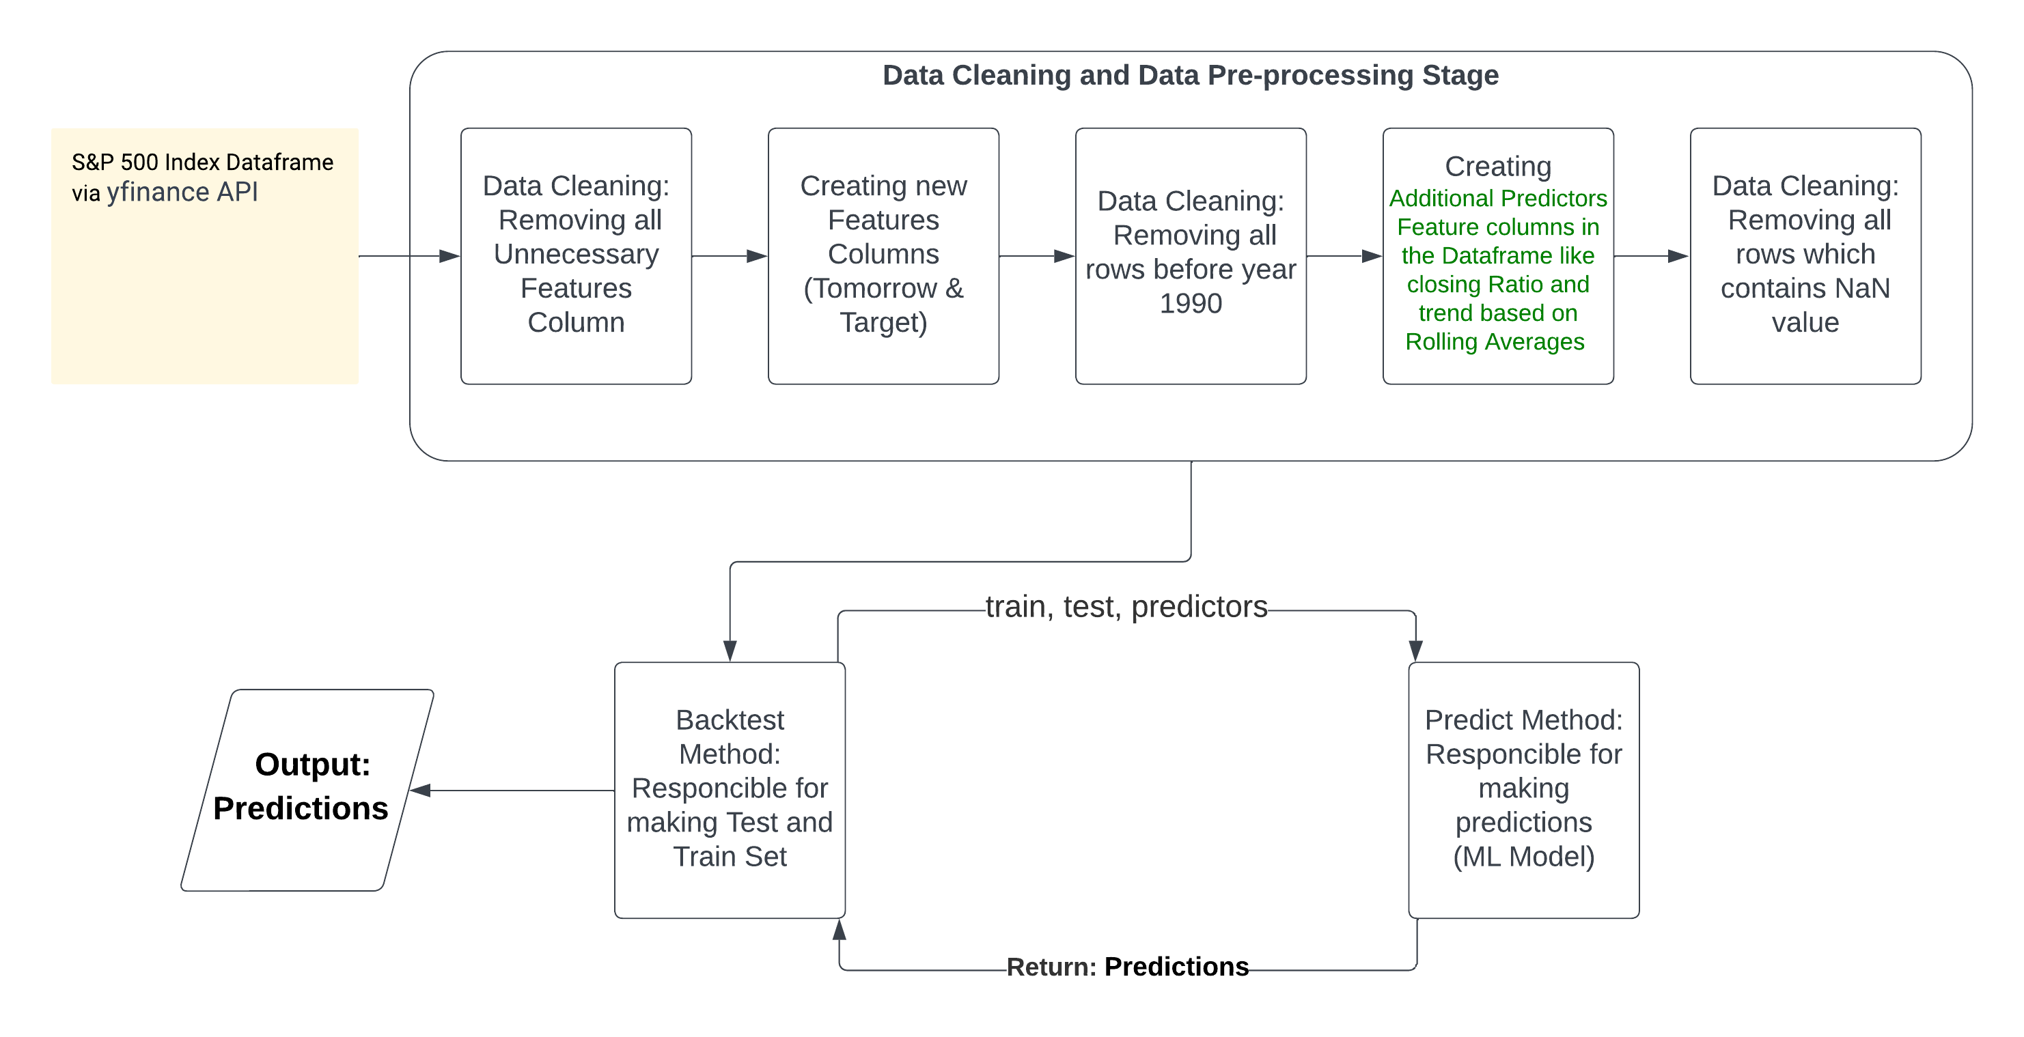
Block Diagram

Slide 10
Proposed Work
Data collection and preprocessing: The first step of the proposed work involves obtaining the necessary data for the S&P 500 index using the yfinance API. The collected data will then undergo preprocessing, including the removal of irrelevant features and the creation of additional predictors such as rolling averages.
Model selection and training: The next phase focuses on selecting an appropriate machine learning algorithm for stock market prediction. Based on our project's objectives, the RandomForestClassifier algorithm has been chosen. The model will be trained using the cleaned dataset, incorporating the target variable and additional predictors.
Model evaluation and performance analysis: Once the model is trained, it will be evaluated using various performance metrics such as accuracy, precision, recall, and F1-score.
Interface development and usability testing: In order to make the model accessible and user-friendly, an interface will be developed to facilitate input of data and retrieval of predictions.
Integration and deployment: The proposed work includes integrating the developed model and interface with existing financial platforms or tools.

Slide 11
Methodology
Data Collection:
Obtain S&P 500 index data using yfinance API.
Collect historical data from the inception of the index.
Remove data prior to the year 1990.
Data Cleaning:
Remove irrelevant features not relevant to index funds.
Create "Tomorrow" column by shifting the current day's closing price.
Create "Target" column based on price comparison between today and tomorrow.
Additional Predictors:
Calculate rolling averages over different time horizons (2, 5, 60, 250, 1000 days).
Compute ratio between today's closing price and rolling averages.
Create trend column indicating the market trend over the rolling horizon.
Model Selection:
Choose RandomForestClassifier algorithm for prediction.
Set parameters: n_estimators=200, min_samples_split=50, random_state=1.

Slide 12
Methodology
Model Training and Testing:
Train the model using the first 10 years of data (2500 trading days).
Step through each year and predict values for the following year.
Evaluate model performance using metrics: accuracy, precision, recall, F1-score.
Integration and Deployment:
Develop an interface for easy input and retrieval of predictions.
Conduct usability testing to ensure the interface is user-friendly.
Integrate the model and interface with financial platforms for practical use.
Continuous Updating and Improvement:
Implement mechanisms to update the model periodically with new data.
Retrain the model to adapt to changing market conditions.
Evaluate and monitor the model's performance for ongoing improvement.

Slide 13

Description of Algorithm used
The Random Forest Classifier algorithm offers several advantages for stock market prediction. It can handle large datasets with a high number of features and effectively deals with missing data. It also provides robustness against overfitting, a common challenge in machine learning models.
In our implementation, we set specific parameters for the Random Forest Classifier, including the number of estimators (200), minimum samples split (50), and random state (1). These parameters control the number of decision trees in the ensemble, the minimum number of samples required to split a node, and the random seed for reproducibility.
By utilizing the Random Forest Classifier algorithm, we aim to harness the collective power of multiple decision trees to accurately predict the future values of the S&P 500 index. This algorithm's ability to handle complex data patterns and deliver reliable predictions makes it well-suited for our project's objectives.
The algorithm used in our project for stock market prediction is the Random Forest Classifier. This algorithm falls under the category of ensemble learning, which combines multiple decision trees to make predictions.
The Random Forest Classifier algorithm works by creating a multitude of decision trees, each trained on a random subset of the data. During the training process, these decision trees learn to make predictions based on different features and patterns in the data.
To make a prediction using the Random Forest Classifier, the algorithm aggregates the predictions of all the individual decision trees and outputs the majority prediction as the final result. This ensemble approach helps to reduce the impact of individual trees' biases and improves the overall accuracy of the predictions.

Slide 14

Proposed Work
Data Collection: We will utilize the yfinance API to obtain a comprehensive dataset of the S&P 500 index, covering a significant time span. This dataset will serve as the foundation for our analysis and prediction tasks.
Data Preprocessing: The collected data will undergo a thorough preprocessing phase. This involves cleaning the data by removing irrelevant features and handling missing values. We will also perform data normalization or scaling to ensure uniformity and optimize the performance of the machine learning algorithms.
Feature Engineering: To enhance the predictive capabilities of our model, we will engineer new features from the available data. This may include calculating rolling averages, technical indicators, or sentiment scores derived from news or social media data. These additional features will provide valuable insights and improve the accuracy of our predictions.
Model Selection: We will explore and evaluate various machine learning algorithms suitable for stock market prediction. This includes algorithms such as Random Forest, Support Vector Machines, or Gradient Boosting. We will compare their performance using appropriate evaluation metrics and select the most effective algorithm for our project.

Slide 15
Proposed Work
Model Training and Validation: The selected machine learning algorithm will be trained on a portion of the dataset using historical stock market data. We will split the data into training and validation sets to assess the model's performance and ensure it generalizes well to unseen data. Cross-validation techniques may also be employed to validate the model's robustness.
Hyperparameter Tuning: We will fine-tune the chosen model by optimizing its hyperparameters. This involves systematically adjusting the model's settings to find the configuration that yields the best performance. Techniques like grid search or random search will be employed to efficiently explore the hyperparameter space.
Model Evaluation: The trained model will be evaluated using appropriate evaluation metrics, such as accuracy, precision, recall, and F1-score. We will assess its performance on the validation set and compare it to baseline models or industry benchmarks. Visualization techniques may be employed to analyze the model's predictions and gain insights into its strengths and weaknesses.
Deployment and Testing: Once we are satisfied with the model's performance, we will deploy it to make predictions on new, unseen data. This will allow us to assess its real-time predictive capabilities and validate its usefulness in practical stock market scenarios. Rigorous testing and validation will be conducted to ensure the model's reliability and accuracy.

Slide 16
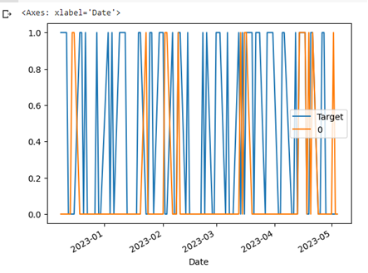
Result Analysis
Our analysis of the model's performance indicates that it is better at predicting negative returns than positive returns. This may be due to the fact that the S&P 500 index generally follows an upward trend over time, and our model may not have been able to capture this trend effectively.

Slide 17
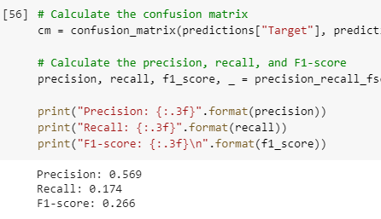
Result Analysis
We trained our model using the first 10 years of data (2500 trading days) and step through each year, predicting the value for the following year. Our model achieved a precision score of 0.5687960687960688, recall of 0.174, and an F1-score of 0.266

Slide 18
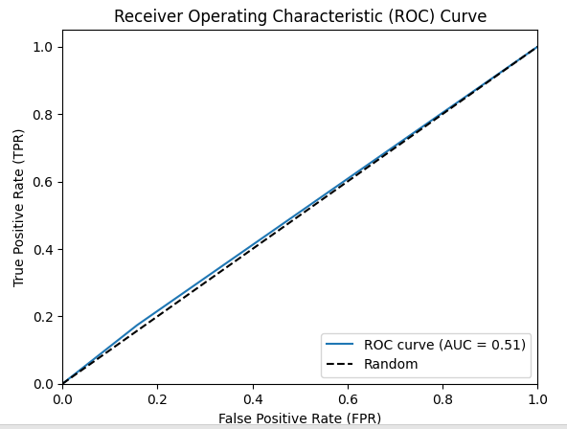
Result Analysis
An AUC (Area Under the Curve) value of 0.51 indicates that the performance of the model is slightly better than random chance. The AUC ranges from 0 to 1, where a value of 0.5 indicates a random classifier and a value of 1 indicates a perfect classifier.
In the case of an AUC value of 0.51, it suggests that the model's ability to distinguish between positive and negative samples is only slightly better than randomly guessing. This means that the model's predictive power is limited, and its performance may not be sufficient for accurate predictions or classifications.
It's important to note that an AUC value of 0.51 does not necessarily mean that the model is entirely ineffective. It may still provide some useful insights or be a starting point for further improvements. However, it indicates that there is room for enhancement and the model's performance should be evaluated further to determine its usefulness in practical applications.

Slide 19
n_estimators & min_samples_split & random_state
n_estimators
min_samples_split
This parameter represents the number of decision trees that will be created in the random forest ensemble. Each decision tree in the ensemble contributes to the final prediction, and a higher number of trees can potentially improve the model's accuracy. However, increasing the number of estimators also increases the computational complexity and training time of the model. It is important to find a balance between model performance and computational efficiency.
This parameter specifies the minimum number of samples required to split an internal node during the construction of each decision tree. When the number of samples in a node falls below this threshold, the node will not be split further, and it becomes a leaf node, resulting in a smaller and more specialized tree. Setting a higher value for min_samples_split can prevent overfitting by ensuring that nodes have a minimum amount of data before they are split. However, setting it too high may lead to underfitting, where the model fails to capture important patterns in the data.

Slide 20
random_state
This parameter is used to set the random seed or random number generator state for the random forest algorithm. Randomness is an inherent part of the random forest algorithm, as it involves creating random subsets of features and data during the training process. By setting random_state to a specific value, you can ensure reproducibility of the results. If the same random_state value is used across multiple runs of the algorithm, the random forest model will produce the same results each time, allowing for better comparison and debugging.

Slide 21
Future Scope
There are several avenues for future research to expand upon the work done in this project. One possible direction is to incorporate more external factors such as economic indicators and geopolitical events that may impact the stock market.
Additionally, exploring other machine learning algorithms and ensembling techniques may yield further improvements in prediction accuracy. Finally, extending the dataset beyond the S&P 500 index to include other indices and individual stocks may provide greater insight into the behaviour of the stock market as a whole.
As new data becomes available, it will be important to update our model and evaluate its performance on the most recent data. This can be done by retraining the model on the most recent data and comparing its predictions to the actual values.
Additionally, as new predictors become available, such as economic indicators and geopolitical events, it will be important to incorporate them into our model and assess their impact on prediction accuracy. Overall, ongoing updates and improvements to our model will be crucial to maintaining its relevance and usefulness in predicting the future values of the S&P 500 index.

Slide 22
References
[1] K. Tsai and J. Wang, "External technology sourcing and innovation performance in LMT sectors", Research Policy, vol. 38, no. 3, pp. 518-526, 2009.
[2] K. Han and J. Kim, "Genetic quantum algorithm and its application to combinatorial optimization problem", Evolutionary Computation, 2000, vol. 2, pp. 1354-1360, 2000.
[3] Atsalakis, G. S., Dimitrakakis, E. M., & Zopounidis, C. D. (2011). Elliott wave theory and neuro- fuzzy systems, in stock market prediction: The WASP system. Expert Systems with Applications, 38, 9196–9206.
[4] Olivier C., Blaise Pascal University: “Neural network modeling for stock movement prediction, state of art”. 2007.
[5] Leng, X. and Miller, H.-G. : “Input dimension reduction for load forecasting based on support vector machines”, IEEE International Conference on Electric Utility Deregulation, Restructuring and Power Technologies (DRPT2004), 2004.

Slide 23
References
[6] Chun C, Qinghua M, Shuqiang L.: “Research on Support Vector Regression in the Stock Market Forecasting” ©Springer, Advances in Intelligent and Soft Computing Volume 148, , pp 607-612, 2012.
[7] Guo Z., Wang H., Liu Q. : “Financial time series forecasting using LPP and SVM optimized by PSO” © Springer, Soft Computing Methodologies and Applications , December 2012.
[8] Tsibouris, G., & Zeidenberg, M. (1995). Testing the efficent markets hypothesis with gradient descent algorithms. In R A (Ed.), Neural networks in the capital markets.John Wiley and Sons.
[9] Guresen, E., Kayakutlu, G., & Daim, T. U. (2011). Using artificial neural network models in stock market index prediction. Expert Systems with Applications, 38(8), 10389–10397.
[10] Gupta, A. :“Stock market prediction using Hidden Markov Models”, IEEE Engineering and Systems (SCES), 2012 Students Conference on, pp.1-4, 2012.
[11] Hassan MR, Nath B. Stock market forecasting using Hidden Markov Model: a new approach. In: Proceedings—5th international conference on intelligent systems design and applications 2005, ISDA’05. 2005. pp. 192–6. https://doi.org/10.1109/ISDA.2005.85.
[12] Lei L. Wavelet neural network prediction method of stock price trend based on rough set attribute reduction. Appl Soft Comput J. 2018; 62:923–32. https://doi.org/10.1016/j.asoc.2017.09.029.

Slide 24


